Slide 1



Arduino 1 – blink
Steven hammer
s.hammer@hw.ac.uk

Slide 2

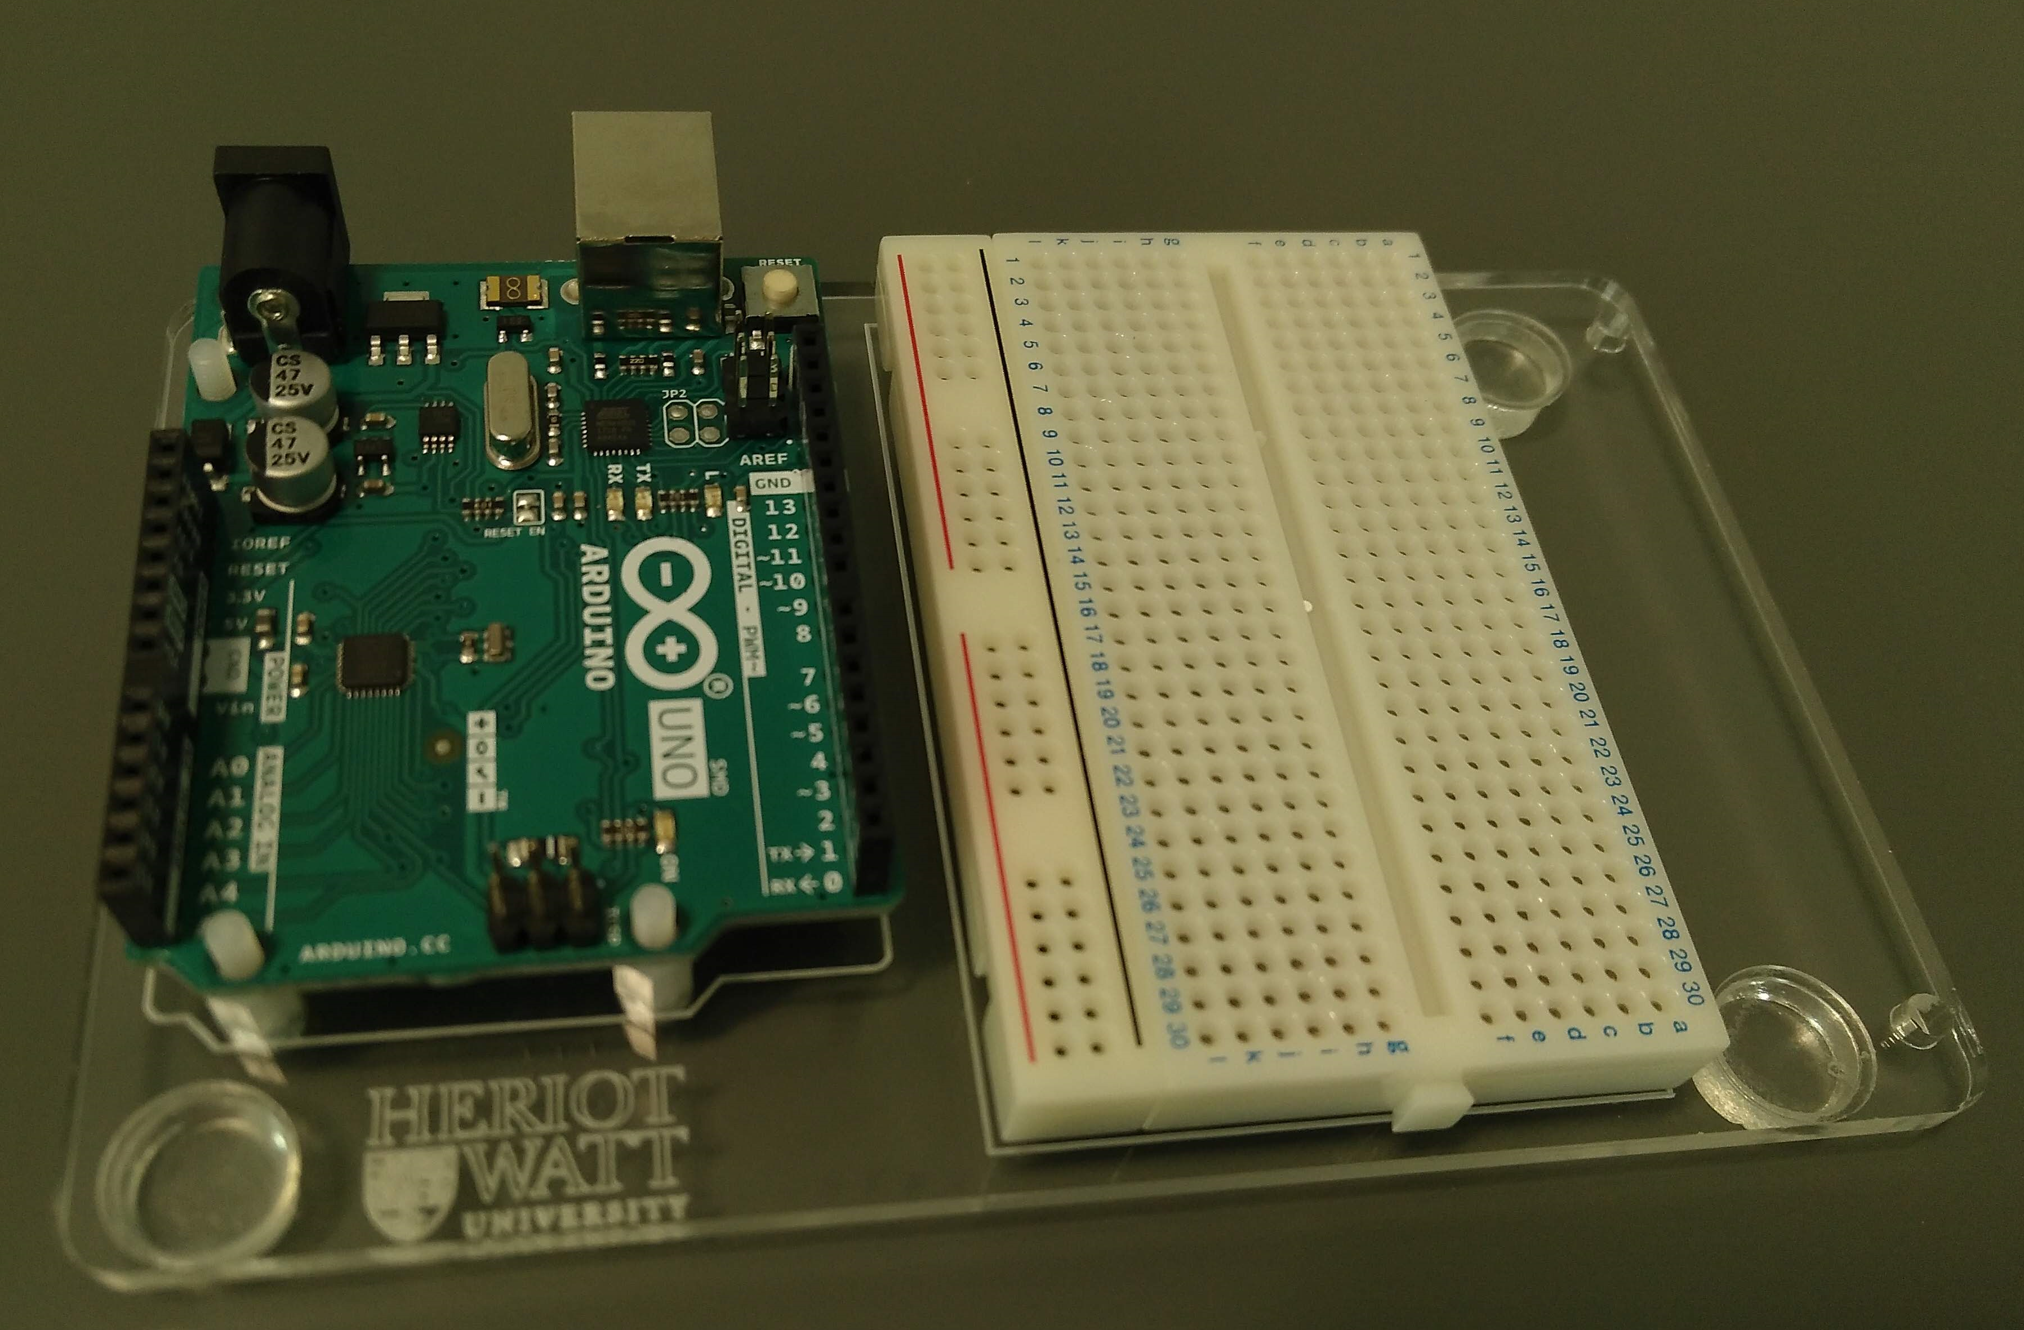
What is Arduino?
Programmable microcontroller
Open source hardware
Versatile, adaptable, lots of community support
Loads of add-ons available

Slide 3
WHY LEARN Arduino?
Measurement – data capture
Control – make motors and actuators work
Projects – future work based on this

Slide 4
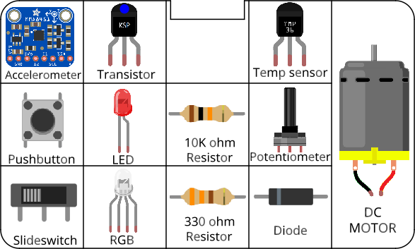
Circuits
All components included in the kit…

Slide 5
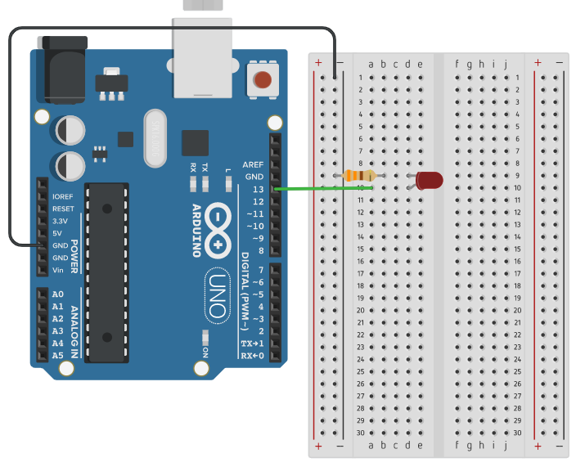
Building circuits
Insert components into breadboard holes
Connect up using instrument wire
Arduino controls inputs and outputs
Follow schematics
NOTE: GND = negative

Slide 6
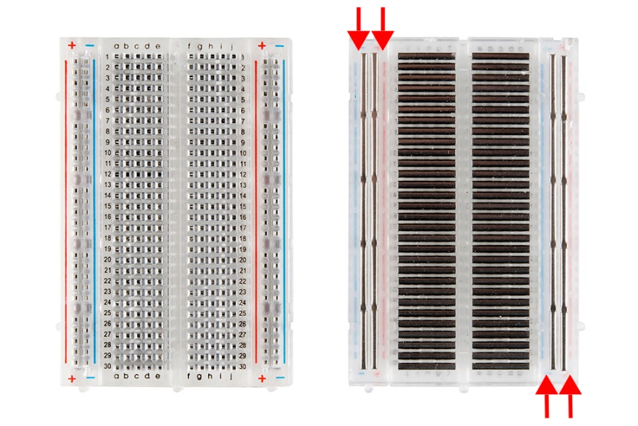
Breadboards
Image source: learn.sparkfun
Horizontal connections have a gap in the middle

Slide 7
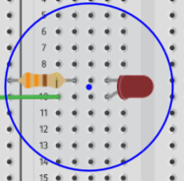
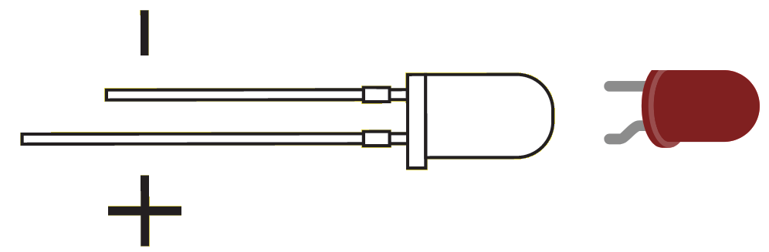
LEDs
Connect long leg (anode) to positive

Slide 8
Debugging circuits
Did I insert the component fully?
Is it the right way round (especially LEDs)?
Is the power connected?
Is it connected to the correct input/output?

Slide 9
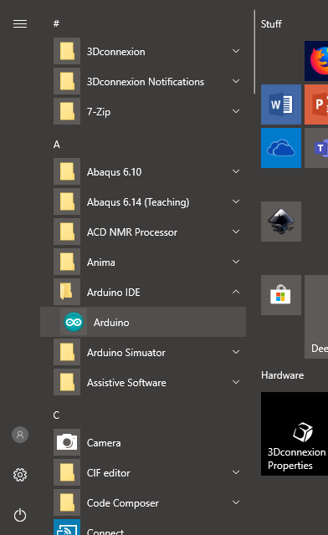
How do I program it?
Arduino IDE
USB cable
C++

Slide 10
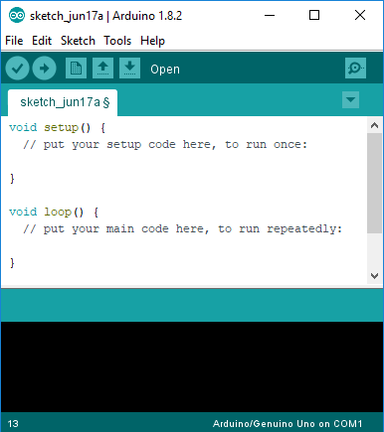
Arduino IDE
Write code
Compile
Download to Arduino
Arduino runs code

Slide 11
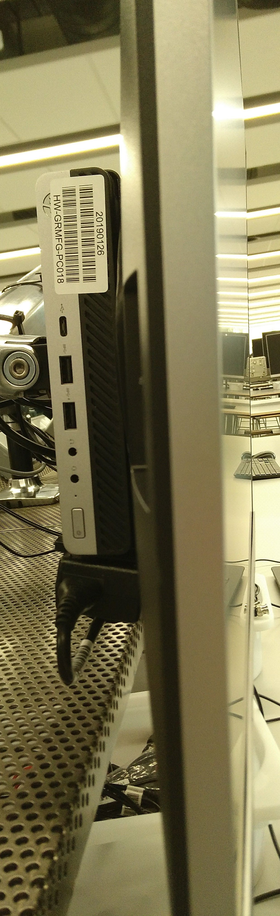
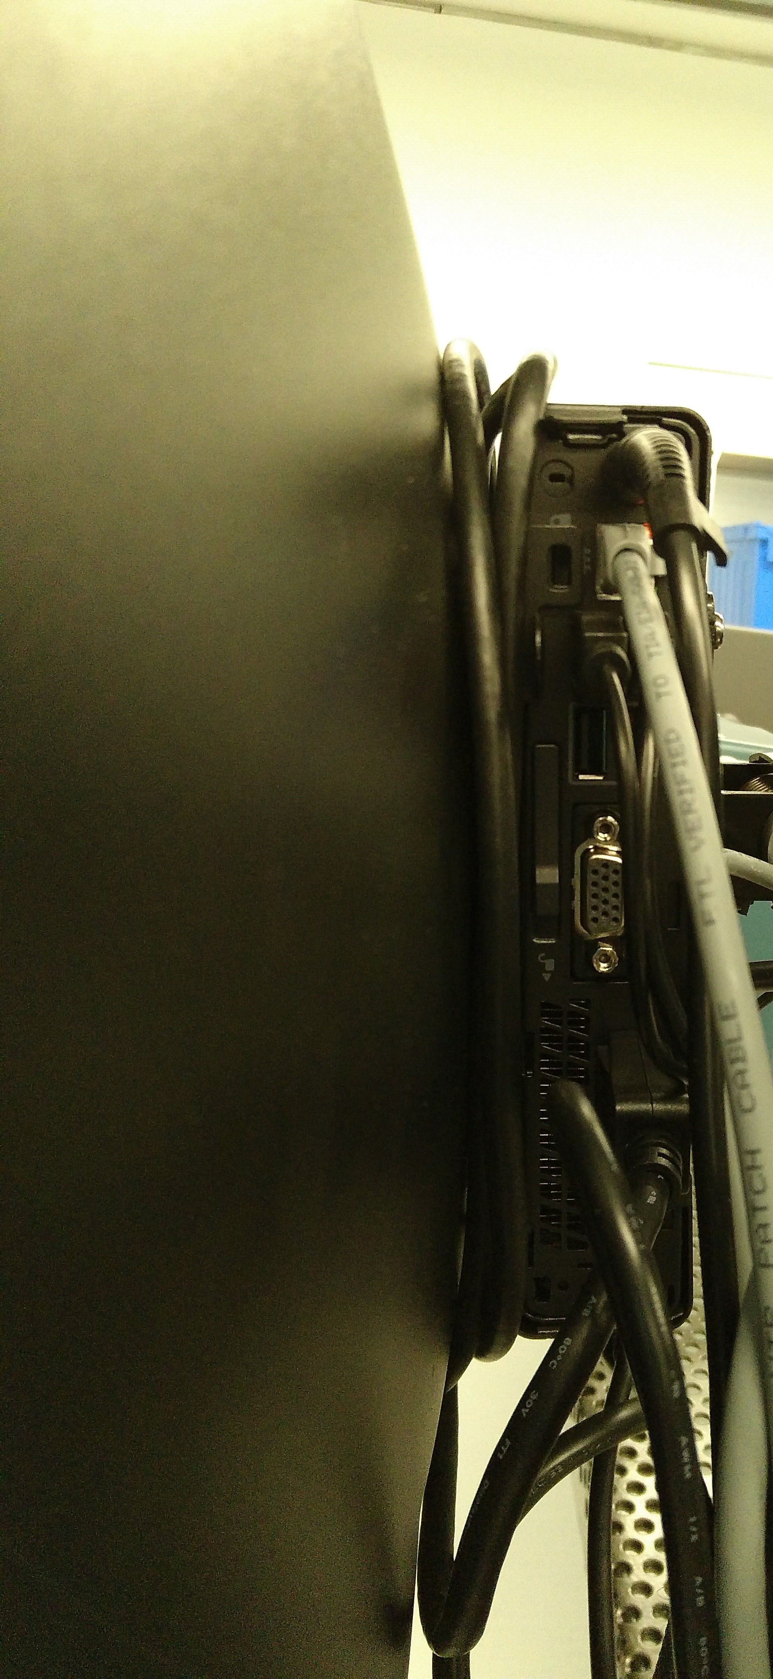
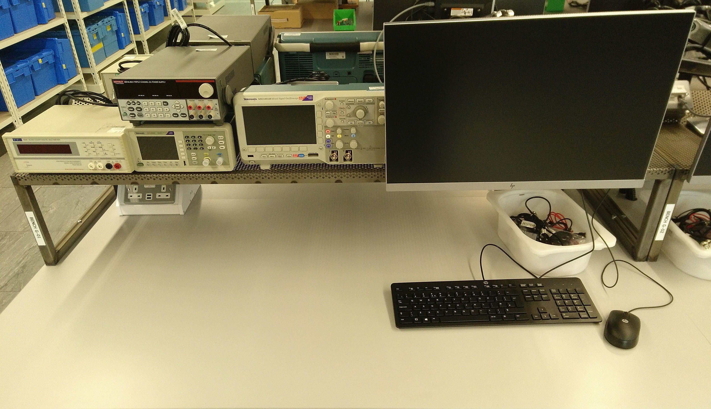
USB connection
USB sockets on front and rear of PCs

Slide 12
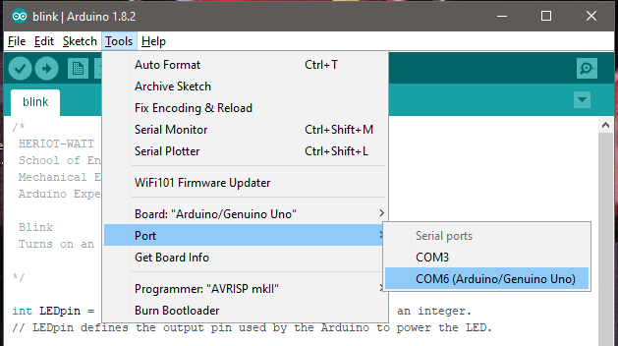
Connecting to ARDUINO
Select COM port (Tools menu)

Slide 13
Debugging code
Is there a space missing somewhere?
Do all lines end with a semicolon;
Is something commented out //

Slide 14
What are we doing today?
Download the blink code to the Arduino
Build the circuit on the breadboard
Make an LED flash

Slide 15
housekeeping
Take two boxes:
One Arduino box
One Sensors and Motion kit
Put components back into labelled places in boxes after use
Any components missing – let us know.

Slide 16
Finished already?
Make the LED blink faster and slower
Add a second LED which flashes out of sync with the other
Make the LED light in time to the bass rhythm in Queen’s Flash

Slide 17
TIDYING up
Return components to your Sensors and Motion box IN THE CORRECT PLACES!!!
Put instrument wire in motor compartment
Return Arduino to its case
Return both boxes to tutor

